Slide 1
PREDICT TRAFFIC AND SEVERITY WITH MACHINE LEARNING
QUANG LA
IBM DATA SCIENCE – COURSERA PROGRAM

Slide 2
Machine Learning Benefits to Traffic Problem
Traffic collisions are a big problem in the US, with average of around 100 death daily.
Machine Learning is an emerging technology but has already been employed by various car manufacturers for increased vehicle safety
Predictive Models can help predict probability of accidents, and convey the result to help drivers take precautions
Predict probability of accident with Logistic Regression
Predict accident severity with classification
With its continuous evolution, Machine Learning will become an important part of a future fully autonomous vehicles.

Slide 3
Data Acquisition and Cleaning
Data for this project was provided by Seattle Depart of Transportation
Includes all accidents from 2004 to present
A total of 38 columns and 194,673 rows
Irrelevant and correlated columns removed
Missing values either removed or replaced depend on column type
Date/time columns were modified to contain more useful information such as quarter of the year and period of the date for accidents
Final dataset includes 14 columns and 184,167 rows

Slide 4
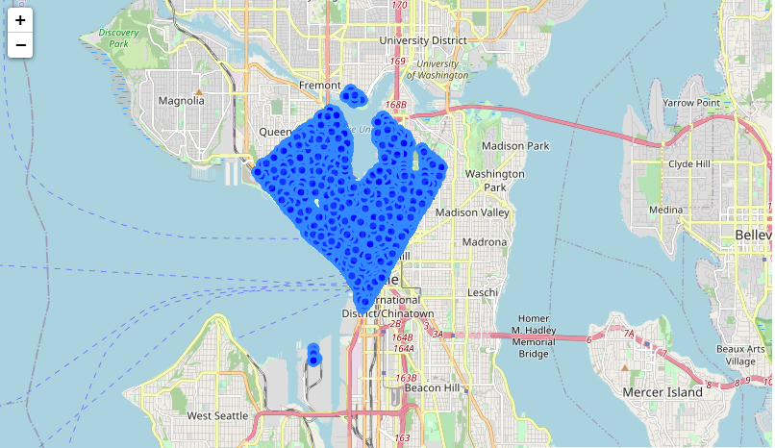
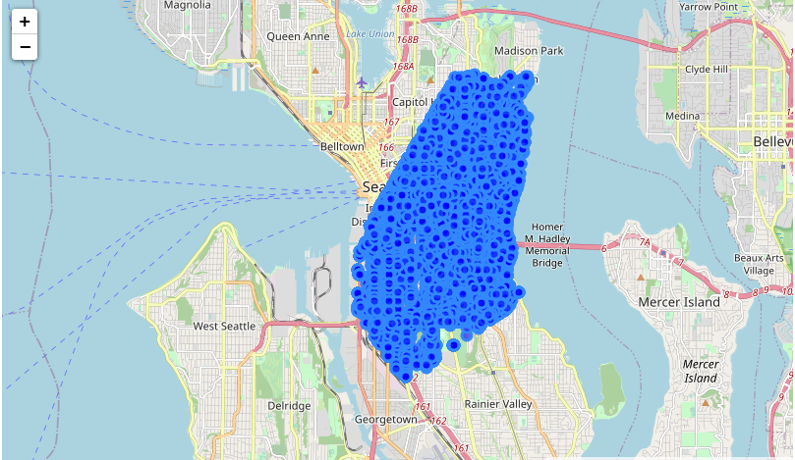
Data Exploration - Location
Coordinates information was transformed into 7 zones with K-nearest Neighbor clustering technique
Locations with highest accidents:
Zone 1 (top figure):
In city downtown area
A lot of foot traffic from workers and tourists
Zone 6 (bottom figure):
Near downtown with more residential zones
Near two main highways connecting downtown and surburbans

Slide 5
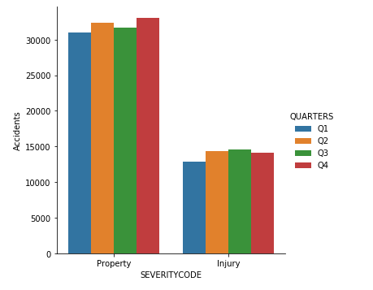
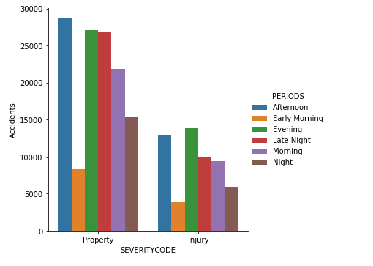
Data Exploration – Date/Time
Date of accidents column was modified to provide quarter number for better categorization
Highest season are quarter 3 and 4, both represents higher traffic volume (vacation for summer Q3 and holidays for winter Q4)
Time of accidents column was categorized into early morning, morning, afternoon, evening, night, and late night
Highest periods are afternoon (rush hours 4pm to 8pm), evening (8pm to 12am), and late evening (12am to 4am)

Slide 6
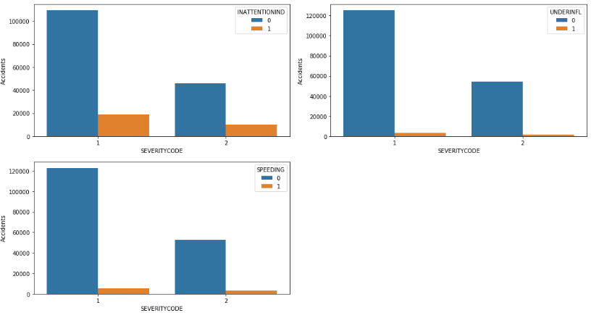
Data Exploration – Human Factors
Charts represent accidents with:
Inattention (top left)
Under influence (top right)
Speeding (bottom left)
Blue chart presents “Not involved” (0)
Orange chart presents “Involved” (1)
The charts did not show a significant relationship between human factors and accidents, which may seem contrast to real life
Might need more data to investigate further

Slide 7
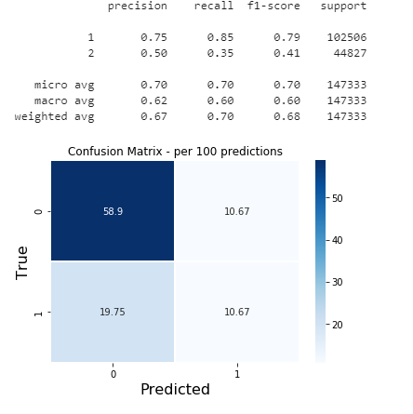
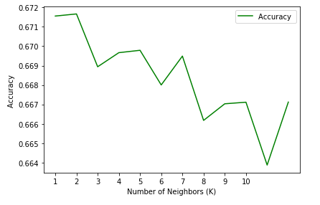
Predictive Model – K-nearest Neighbor
Require Principal Component Analysis (PCA) to reduce data dimensionality and processing time
Pipeline and Grid Search for best parameters
PCA components: 5
k: 5
Accuracy score: 0.6698

Slide 8
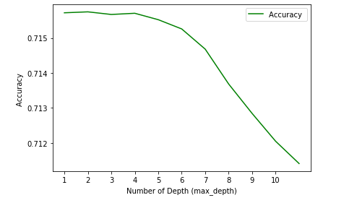
Predictive Model – Decision Tree
Grid Search for best parameters
Max Tree Depth: 5
Accuracy score: 0.7155

Slide 9
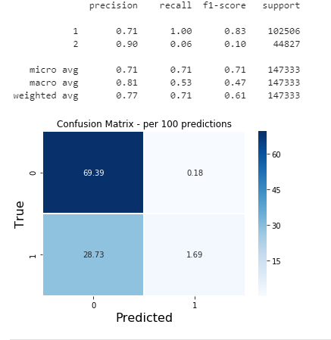
Predictive Model – Support Vector Machine
Require linear kernel since there’re more than 100,000 data observation
Use LinearSVC class instead of SVC to better scale large dataset
Employ PCA again to reduce data dimensionality and processing time
Best PCA components: 5
Accuracy score: 0.7108

Slide 10
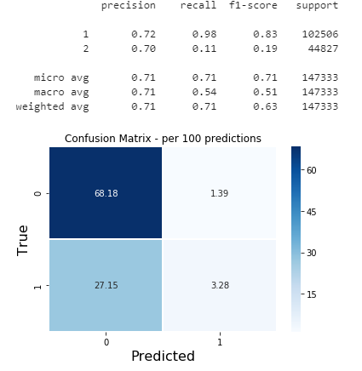
Predictive Model – Logistic Regression
Grid Search for best parameters
Solver: newton-cg
Inverse of regularization strength: 0.001
Accuracy score: 0.7146

Slide 11
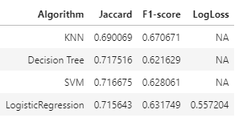
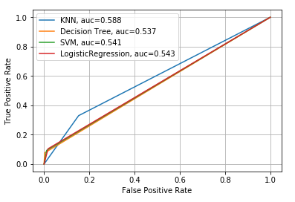
Predictive Model – Performance Comparison
KNN model has the best F-1 score, with a 7.5% margin compared to next best performance
ROC curve created with SEVERITY code 2 as positive label
KNN also has the best True Positive Rate
AUC value reinforces KNN performance
In some cases, Logistic Regression is more beneficial because of predicted probability
Need more data to fine-tune the model

Slide 12
Conclusion and Future Directions
Useful models were built to predict car accident and severity
Accuracy for model can be improved
New data type collected (for example – fatality count) to use as feature
More data observation
Future direction – Multiple Classification
More severity code based on fatalities, vehicle, pedestrian, etc.. counts
More advanced predictive models to meet the larger and more dimensional dataset

